Slide 1
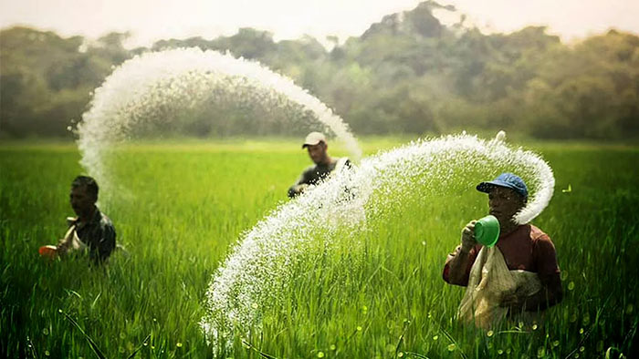


Update Market and Business Environment Report—Agrochemicals
Prepared By:
Prepared For:
www.chemanalyst.com
December 17, 2022

Slide 2
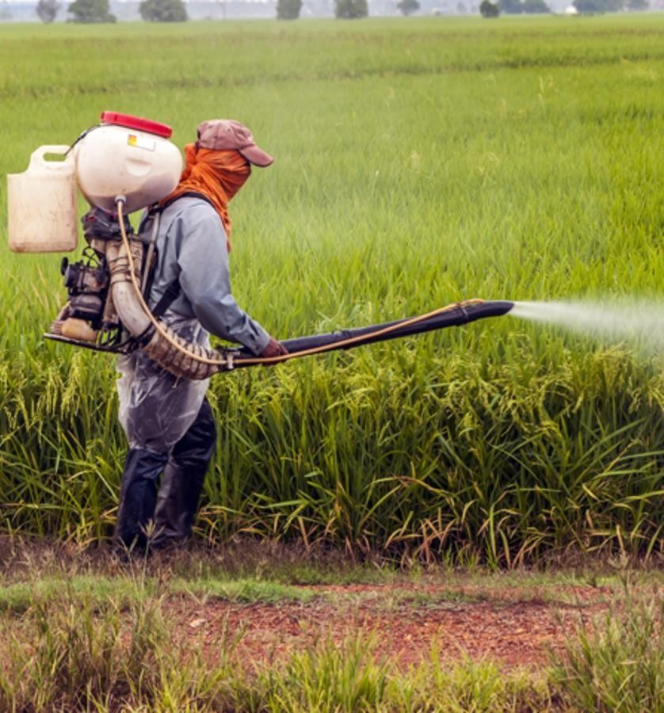
Agrochemicals

Slide 3
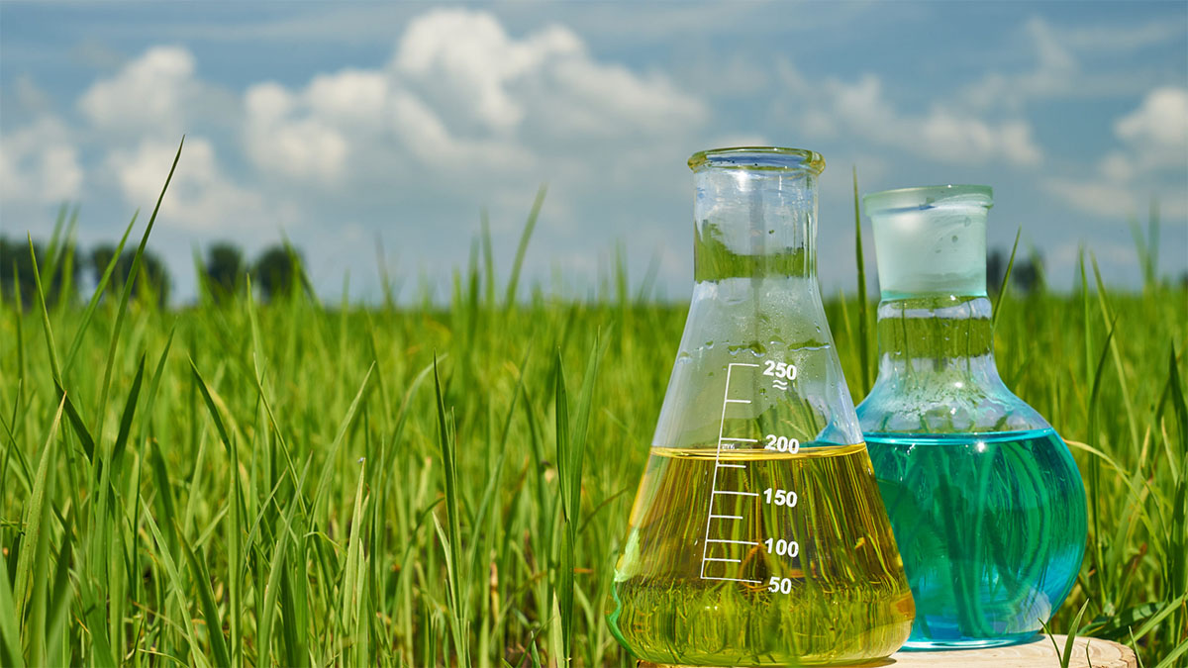
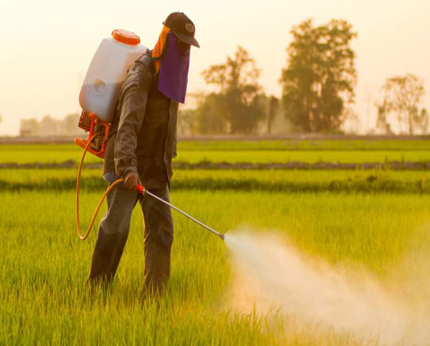
Product Overview- Agrochemicals
Agrochemicals are pesticides, herbicides, or fertilizers used for the management of ecosystems in agricultural sectors. Rudimentary variations on agrochemicals have been used for millennia to improve crop yields and control the populations of agricultural pests.
The earliest known use of agrochemicals dates to roughly 2500 B.C. when Sumerian farmers relied on Sulphur (S) compounds to reduce insect populations and the subsequent risk of pest-related famine.
Types of Agrochemicals-
There is a concerted effort to actively and conscientiously implement a broad range of agrochemicals to safely maintain and control the global food supply to ensure consistently high quality for widespread consumption. Types of agrochemicals include:
Pesticides, or chemicals engineered to destroy insects and other organisms, weeds, and funguses that could spoil crop yields;
Synthetic fertilizers, for example ammonium nitrate (NH4NO3), which is designed to encourage crop growth by saturating soils with nutrients;
Acidifiers and liming agents, engineered to alter the pH levels of soils to suit the planting properties of given crops;
Soil conditioners, for example gypsum (CaSO4·2H2O), which is designed to condition soils with high sodium (Na) contents to improve planting conditions;
Growth hormones, or synthetic chemicals designed to increase growth rates in animals and crops.

Slide 4
Global Agrochemicals Market, By Value & Volume
Figure 1: Global Agrochemicals Market Size, By Value (USD Billion) & By Volume (in MMT), 2017, 2021, 2025F, 2030F, 2035F, 2040F
CAGR 2017-2021
By Value: 2.9%
CAGR 2021-2030F
By Value: 4.5%
CAGR 2030-2040F
By Value: 3.4%
CAGR 2017-2021
By Volume: 2.3%
CAGR 2021-2030F
By Volume: 3.9%
CAGR 2030-2040F
By Volume: 3.0%
Global Agrochemicals market stood at USD 220 billion and is expected to reach USD 324 billion at a CAGR of 4.5% by 2030 and 454 billion by the end of 2040 at a CAGR of 3.4%.
Covid did not affected the agrochemicals market owing to increase in demand of consumables in that period.
Initiatives such as “Make in India” and the PLI Scheme improve the manufacturing sector dynamics of India, and hence more industries are established.
Source: ChemAnalyst

Slide 5
Global Agrochemicals Market, By Value
Figure 2: Global Agrochemicals Market, By Type, By Value (USD Billion), 2017, 2021, 2025F, 2030F, 2035F, 2040F
Total in USD Billion
197
220
256
324
390
454
Others: Biopesticides, etc.
Insecticides is India's most demanded Agrochemicals, having a market share of more than 50%, and it stood at USD 117.8 billion in FY2021.
In the forecast period, it is expected that insecticides will dominate the agrochemicals with a market share of over 50%.
Source: ChemAnalyst

Slide 6
Global Agrochemicals Market, By Volume
Figure 3: Global Agrochemicals Market, By Type, By Volume (MMT), 2017, 2021, 2025F, 2030F, 2035F, 2040F
Total in MMT
171
187
213
263
309
355
Others: Biopesticides, etc.
Source: ChemAnalyst

Slide 7
India Agrochemicals Market, By Value & Volume
Figure 4: India Agrochemicals Market Size, By Value (USD Billion) & By Volume (in MMT), 2017, 2021, 2025F, 2030F, 2035F, 2040F
CAGR 2017-2021
By Value: 8.3%
CAGR 2021-2030F
By Value: 10.4%
CAGR 2030-2040F
By Value: 8.4%
CAGR 2017-2021
By Volume: 8.0%
CAGR 2021-2030F
By Volume: 9.8%
CAGR 2030-2040F
By Volume: 8.1%
India Agrochemicals market stood at USD 6.3 billion and is expected to reach USD 15.2 billion at a CAGR of 10.4% by 2030 and 34.7 billion by the end of 2040 at a CAGR of 8.4%.
India is the fourth-largest producer of agrochemicals in the world after USA, Japan and China.
The major dynamics to the agrochemicals market includes, decreasing arable land, declining soil fertility, heavy dependency on monsoon for irrigation and many more.
Source: ChemAnalyst

Slide 8
India Agrochemicals Market, By Value
Figure 5: India Agrochemicals Market, By Type, By Value (USD Billion), 2017, 2021, 2025F, 2030F, 2035F, 2040F
Total in USD Billion
5
6
9
15
24
35
Others: Biopesticides, etc.
Source: ChemAnalyst

Slide 9
India Agrochemicals Market, By Volume
Figure 6: India Agrochemicals Market, By Type, By Volume (MMT), 2017, 2021, 2025F, 2030F, 2035F, 2040F
Total in MMT
3
4
6
10
15
21
Others: Biopesticides, etc.
Source: ChemAnalyst

Slide 10
India Agrochemicals Market, By Value
Figure 7: India Agrochemicals Market, By Region, By Value (USD Billion), 2017, 2021, 2025F, 2030F, 2035F, 2040F
Total in USD Billion
5
6
9
15
24
35
Others: Biopesticides, etc.
Source: ChemAnalyst

Slide 11
India Agrochemicals Market, By Volume
Figure 8: India Agrochemicals Market, By Region, By Volume (MMT), 2017, 2021, 2025F, 2030F, 2035F, 2040F
Total in MMT
3
4
6
10
15
21
Others: Biopesticides, etc.
Source: ChemAnalyst

Slide 12
North India Agrochemicals Market, By Value & Volume
Figure 9: North India Agrochemicals Market Size, By Value (USD Billion) & By Volume (in MMT), 2017, 2021, 2025F, 2030F, 2035F, 2040F
CAGR 2017-2021
By Value: 8.34%
CAGR 2021-2030F
By Value: 10.31%
CAGR 2030-2040F
By Value: 8.58%
CAGR 2017-2021
By Volume: 7.98%
CAGR 2021-2030F
By Volume: 9.83%
CAGR 2030-2040F
By Volume: 8.32%
North India Agrochemicals market stood at USD 1.37 billion and is expected to reach USD 15.2 billion at a CAGR of 10.4% by 2030 and 34.7 billion by the end of 2040 at a CAGR of 8.4%.
India is the fourth-largest producer of agrochemicals in the world after USA, Japan and China.
The major dynamics to the agrochemicals market includes, decreasing arable land, declining soil fertility, heavy dependency on monsoon for irrigation and many more.
Source: ChemAnalyst

Slide 13
North India Agrochemicals Market, By Value
Figure 10: North India Agrochemicals Market, By Type, By Value (USD Billion), 2017, 2021, 2025F, 2030F, 2035F, 2040F
Total in USD Billion
1
2
3
5
7
10
Others: Biopesticides, etc.
Source: ChemAnalyst

Slide 14
North India Agrochemicals Market, By Volume
Figure 11: North India Agrochemicals Market, By Type, By Volume (MMT), 2017, 2021, 2025F, 2030F, 2035F, 2040F
Total in MMT
1
1
2
3
4
6
Others: Biopesticides, etc.
Source: ChemAnalyst

Slide 15
West India Agrochemicals Market, By Value & Volume
Figure 12: West India Agrochemicals Market Size, By Value (USD Billion) & By Volume (in MMT), 2017, 2021, 2025F, 2030F, 2035F, 2040F
CAGR 2017-2021
By Value: 8.4%
CAGR 2021-2030F
By Value: 10.4%
CAGR 2030-2040F
By Value: 8.6%
CAGR 2017-2021
By Volume: 8.1%
CAGR 2021-2030F
By Volume: 9.9%
CAGR 2030-2040F
By Volume: 8.3%
India Agrochemicals market stood at USD 6.3 billion and is expected to reach USD 15.2 billion at a CAGR of 10.4% by 2030 and 34.7 billion by the end of 2040 at a CAGR of 8.4%.
India is the fourth-largest producer of agrochemicals in the world after USA, Japan and China.
The major dynamics to the agrochemicals market includes, decreasing arable land, declining soil fertility, heavy dependency on monsoon for irrigation and many more.
Source: ChemAnalyst

Slide 16
West India Agrochemicals Market, By Value
Figure 13: West India Agrochemicals Market, By Type, By Value (USD Billion), 2017, 2021, 2025F, 2030F, 2035F, 2040F
Total in USD Billion
1
2
2
3
4
6
Others: Biopesticides, etc.
Source: ChemAnalyst

Slide 17
West India Agrochemicals Market, By Volume
Figure 14: West India Agrochemicals Market, By Type, By Volume (MMT), 2017, 2021, 2025F, 2030F, 2035F, 2040F
Total in MMT
1
1
1
2
3
4
Others: Biopesticides, etc.
Source: ChemAnalyst

Slide 18
South India Agrochemicals Market, By Value & Volume
Figure 15: South India Agrochemicals Market Size, By Value (USD Billion) & By Volume (in MMT), 2017, 2021, 2025F, 2030F, 2035F, 2040F
CAGR 2017-2021
By Value: 8.3%
CAGR 2021-2030F
By Value: 10.4%
CAGR 2030-2040F
By Value: 8.6%
CAGR 2017-2021
By Volume: 8.0%
CAGR 2021-2030F
By Volume: 9.8%
CAGR 2030-2040F
By Volume: 8.3%
India Agrochemicals market stood at USD 6.3 billion and is expected to reach USD 15.2 billion at a CAGR of 10.4% by 2030 and 34.7 billion by the end of 2040 at a CAGR of 8.4%.
India is the fourth-largest producer of agrochemicals in the world after USA, Japan and China.
The major dynamics to the agrochemicals market includes, decreasing arable land, declining soil fertility, heavy dependency on monsoon for irrigation and many more.
Source: ChemAnalyst

Slide 19
South India Agrochemicals Market, By Value
Figure 16: South India Agrochemicals Market, By Type, By Value (USD Billion), 2017, 2021, 2025F, 2030F, 2035F, 2040F
Total in USD Billion
1
2
3
5
8
11
Others: Biopesticides, etc.
Source: ChemAnalyst

Slide 20
South India Agrochemicals Market, By Volume
Figure 17: South India Agrochemicals Market, By Type, By Volume (MMT), 2017, 2021, 2025F, 2030F, 2035F, 2040F
Total in MMT
1
1
2
3
4
6
Others: Biopesticides, etc.
Source: ChemAnalyst

Slide 21
East India Agrochemicals Market, By Value & Volume
Figure 18: East India Agrochemicals Market Size, By Value (USD Billion) & By Volume (in MMT), 2017, 2021, 2025F, 2030F, 2035F, 2040F
CAGR 2017-2021
By Value: 8.2%
CAGR 2021-2030F
By Value: 10.1%
CAGR 2030-2040F
By Value: 8.5%
CAGR 2017-2021
By Volume: 7.9%
CAGR 2021-2030F
By Volume: 9.6%
CAGR 2030-2040F
By Volume: 8.2%
India Agrochemicals market stood at USD 6.3 billion and is expected to reach USD 15.2 billion at a CAGR of 10.4% by 2030 and 34.7 billion by the end of 2040 at a CAGR of 8.4%.
India is the fourth-largest producer of agrochemicals in the world after USA, Japan and China.
The major dynamics to the agrochemicals market includes, decreasing arable land, declining soil fertility, heavy dependency on monsoon for irrigation and many more.
Source: ChemAnalyst

Slide 22
East India Agrochemicals Market, By Value
Figure 19: East India Agrochemicals Market, By Type, By Value (USD Billion), 2017, 2021, 2025F, 2030F, 2035F, 2040F
Total in USD Billion
1
1
2
3
5
35
Others: Biopesticides, etc.
Source: ChemAnalyst

Slide 23
East India Agrochemicals Market, By Volume
Figure 20: East India Agrochemicals Market, By Type, By Volume (MMT), 2017, 2021, 2025F, 2030F, 2035F, 2040F
Total in MMT
1
1
1
2
4
5
Others: Biopesticides, etc.
Source: ChemAnalyst

Slide 24







Disclaimer :
The contents of this report are based on information generally available to the public from sources and primary interviews which are believed to be reliable. No representation is made that it is timely, accurate or complete. TechSci Research has taken due care and caution in compilation of data as this has been obtained from various sources including primary interviews which it considers reliable and firsthand. However, TechSci Research does not guarantee the accuracy, adequacy or completeness of any information and it is not responsible for any errors or omissions or for the results obtained from the use of such information and especially states that it has no financial liability whatsoever to the subscribers / users of this report. The information herein, together with all estimates and forecasts, can change without notice. All the figures provided in this document are indicative of relative market size and are strictly for client’s internal consumption. Usage of the same for purpose other than internal will require prior approval of TechSci Research.
CONTACT US
TechSci Research – North America
2950, Boundary Road, Burnaby, British Columbia, Canada
Tel: +1- 646- 360-1656
E: sales@techsciresearch.com
TechSci Research – Europe
54, Oldbrook, Bretton,
Peterborough,
United Kingdom
E: sales@techsciresearch.com
TechSci Research – Asia-Pacific
B-44, Sector -57, Noida, National Capital Region, UP, India
Tel: +91-120-4523900
E: sales@techsciresearch.com
TechSci Research
Cyber City, Building No. 8C, Gurgaon, National Capital Region, Haryana, India
Tel: +91-124-6428661
E: sales@techsciresearch.com
www.techsciresearch.com
INDUSTRY ASSOCIATIONS
The information contained herein is of a general nature and is not intended to address any particular situation, individual or entity. No one should act upon such information without appropriate professional advice.
2021 © TechSci Research All Rights Reserved.

